Slide 1
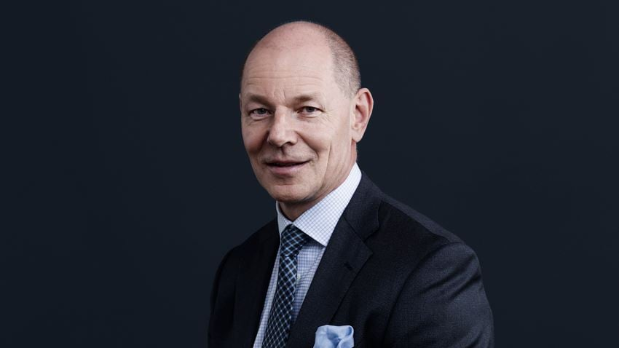
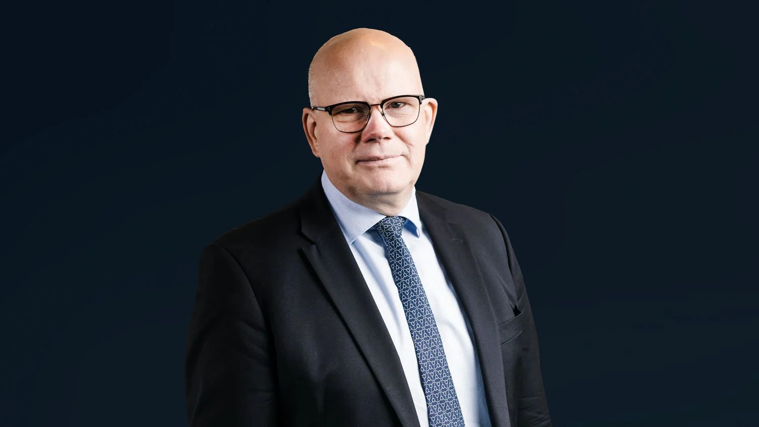
Proposed members for YIT Corporation’s Board of Directors 2023
Harri Pekka Kaukonen
Chairman
Born 1963, Ph.D., Computational material physics,
M.Sc. (Eng., Technical Physics)
Citizenship: Finland
Chairman of the Board 2018–
Member of the Investment and Project Committee 2019–
Chairman of the Personnel Committee 2018–2022; Member of the Personnel Committee 2022–
Independent of the Company and its major shareholders
Primary work experience
Sanoma Corporation, President and CEO 2011–2015
Oy Karl Fazer Ab, various executive positions 2003–2011
McKinsey & Company, partner 1999–2003
Positions of trust
Lindström Oy, Chairman of the Board
TietoEVRY Oyj, Member of the Board, Chairman of the Audit and Risk Committee
Suomen Vaka-palvelut II Oy (Touhula varhaiskasvatus), Chairman of the Board
Gubbe Sydänystävä Oy, Chairman of the Board
Jyri Luomakoski
Vice Chairman
Born 1967, MBA
Citizenship: Finland
Member of the Board 2022–
Member of the Audit Committee 2022–
Independent of the Company and its major shareholders
Primary work experience
Uponor Group: President and CEO 2008–2021; Deputy CEO 2002–2008; CFO 1999-2008
Asko Oyj and Oy Uponor Ab: CFO 1999
Various managerial positions at Oy Uponor Ab, Oy Lars Krogius Ab and Datatrans Finland and Germany
Positions of trust
Purmo Group, Member of the Board and Chairman of the Audit Committee 2021–
Fiskars Group: Vice Chairman of the Board 2018–; Chairman of the Audit Committee 2016–Varma Mutual Pension Insurance Company: Member of the Board and of the Audit Committee 2015–

Slide 2
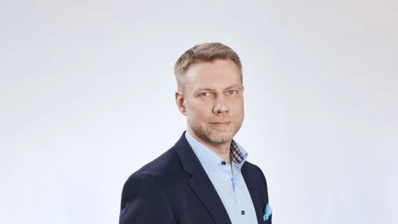
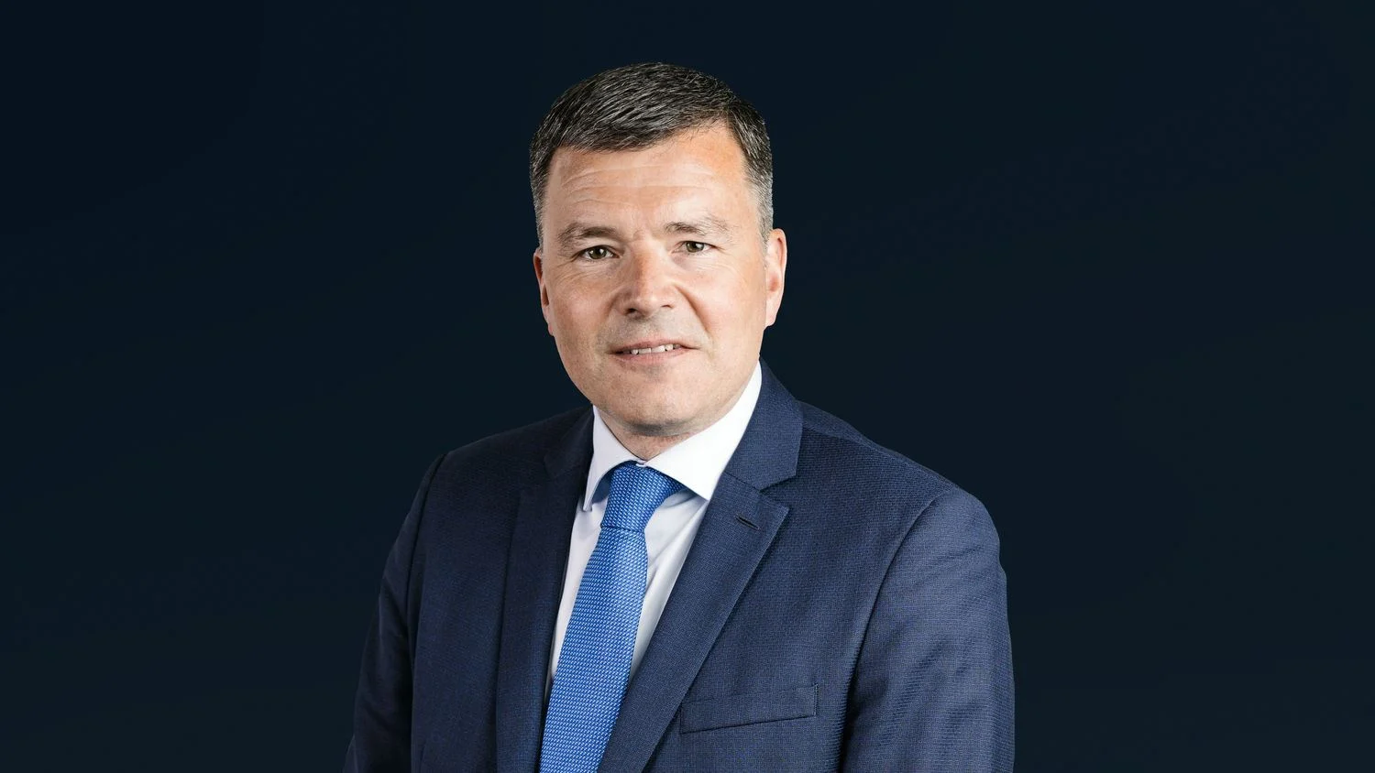
Proposed members for YIT Corporation’s Board of Directors 2023
Sami Laine
Member
Born 1971, M.Sc.(Econ.)
Citizenship: Finland
Mamber of the Board 2022–
Member of the Audit Committee 2022–
Independent of the Company and its major shareholders
Previous positions
Parmaco Group, CEO 2020 – 2021
Technopolis Oyj, CEO 2019 – 2020, CFO 2017 – 2019
Renor Oy, CFO 2016 – 2017
Oriola-KD Oyj, Group Treasurer/Head of Investor Relations 2014 – 2016
SATO Oyj, Group Treasurer 2009 – 2014
Etteplan Oyj, Group Treasurer 2008 – 2009
Uponor Corporation, Treasurer Analyst 2007 – 2008
Casino Amherst International Ltd, Manger 1994 – 2002
Positions of trust
Naava Group Oy, Member of the Board 2023–
Casimir Lindholm
Member
Born 1971, M.Sc.(Econ.), MBA
President and CEO at Cargotec Oyj from 1 April 2023
Citizenship: Finland
Member of the Board 2022–
Member of the Investment and Project Committee 2022–
Independent of the Company and its major shareholders
Previous positions
Eltel Group, President and CEO, 2018–2022
Lemminkäinen Group: President and CEO, 2014–2018; Deputy to CEO 2014;
Executive Vice President, Building Construction Finland 2013–2014
Eltel Group and Eltel Networks Infranet AB: various managerial positions, 2008–2012
Positions of trust
Cargotec Oyj, Member of the Board 2021–2023

Slide 3
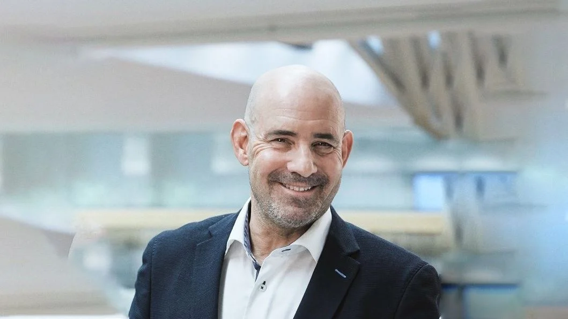
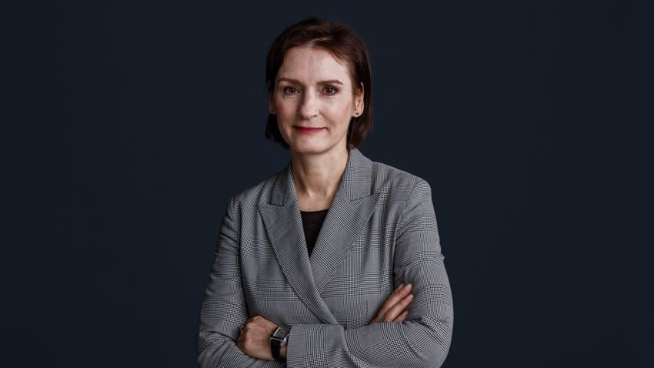
Proposed members for YIT Corporation’s Board of Directors 2023
Keith Silverang
Member
Born 1961, BA, MBA
Citizenship: Finland, United States
Member of the Board 2022−
Member of the Personnel Committee 2022−
Independent of the Company and its major shareholders
Previous positions
Basemark Oy, CEO 2019 – 2021
Technopolis Plc, CEO 2008 – 2019; Director, Helsinki Metro Area unit 2006 – 2008
Technopolis Ventures Ltd, CEO 2004 – 2006
AAC Global, COO 2000–2004
Positions of trust
Basemark Oy, Board member
Granlund Oy, Board member
Barbara Topolska
Member
MBA
Current position: CPI Property Group, Poland, General Director
Citizenship: Poland
Member of the Board 2019‒
Member of the Investment and Project Committee 2019‒
Independent of the Company and its major shareholders
Previous positions
Multi Poland, Managing Director CEE, 2016−2018
Neinver SA, Madrid, Chief Operations Officer 2012− ; General Director, Poland, France and Germany 2008−2012; General Director, Neinver Poland 2003−2008
Positions of trust
International Council of Shopping Centres, Member
ICSC Global Awards, Jury Member

Slide 4
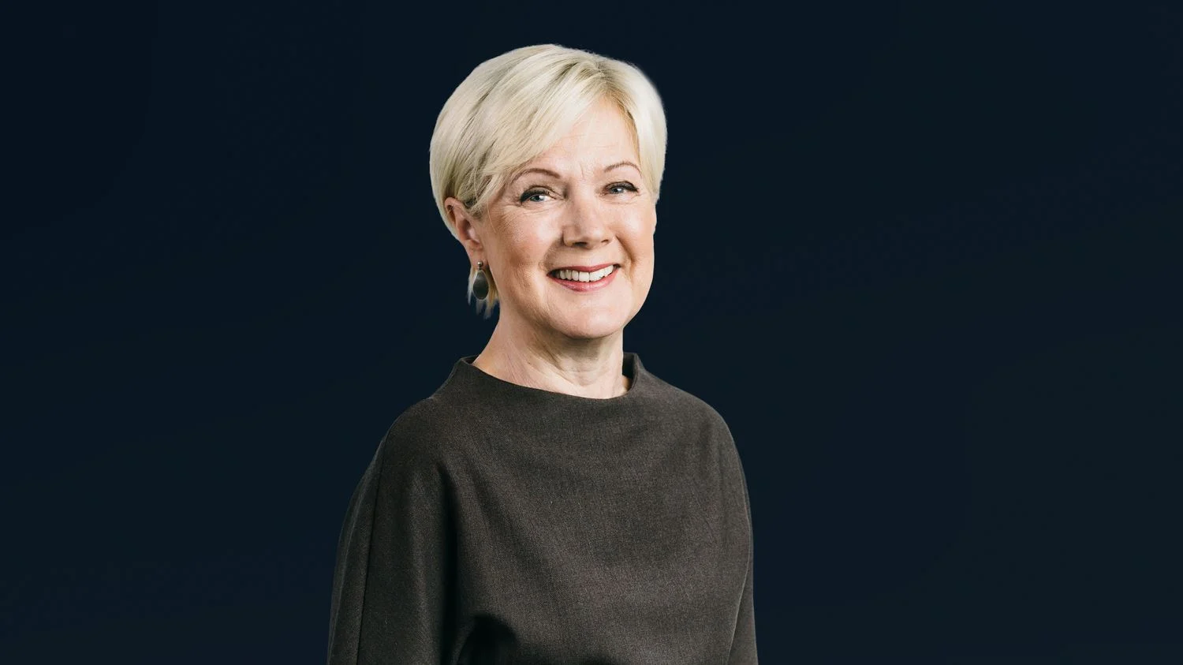
Proposed members for YIT Corporation’s Board of Directors 2023
Kerttu Tuomas
Member
born 1957, B.Sc.(Econ.)
Citizenship: Finnish
Member of the Board 2022−
Chair of the Personnel Committee 2022−
Independent of the Company and its major shareholders
Previous positions
Kone Corporation, Executive Vice President Human Resources and Member of Executive Board 2002–2017
Elcoteq Network Oyj, Group Vice President, Human Resources and Member of the Group Management Team 2000–2002
MasterFoods Oy (Mars), HR manager 1994–1999
Mercuri Urval, Consultant, 1987–1993
Positions of trust
Huhtamäki Oyj, Vice Chairman of the Board 2019–; Member of the Board 2017–
Medix Biochemica Group Oy, Member of the Board 2018–
Finnish National Opera and Ballet, Member of the Board 2016–

